Slide 1

HANDS-ON SESSION:
DEVELOPING ANALYTIC APPLICATIONS USING APACHE SPARK™ AND PYTHON
Pre-required steps
PyCon 2016, Portland
David Taieb
STSM - IBM Cloud Data Services
Developer advocate
david_taieb@us.ibm.com

Slide 2
STEP 1
Sign up for Bluemix

Slide 3
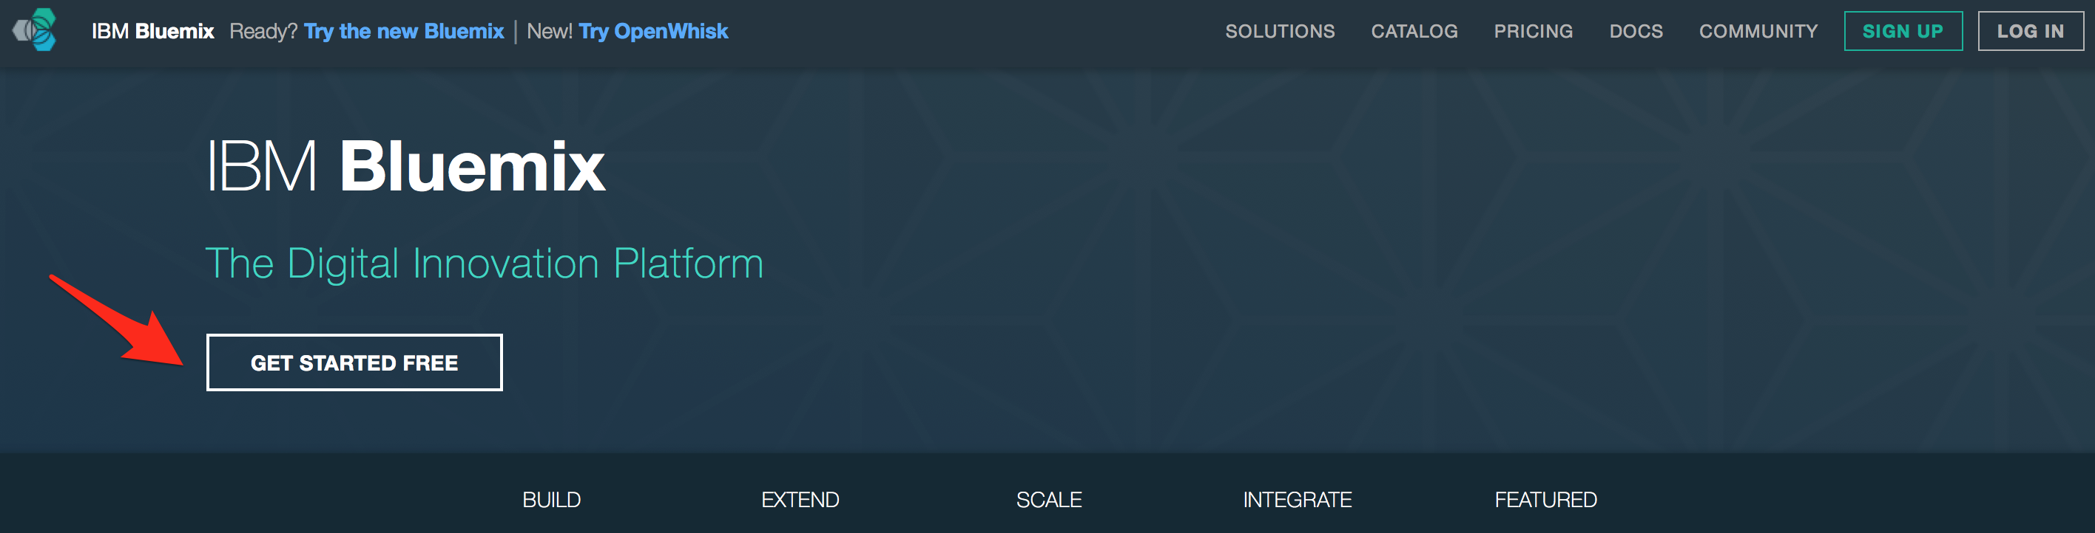
Sign up for Bluemix
Access IBM Bluemix website on https://console.ng.bluemix.net
Click on Get Started for Free
Complete the form and click Create account
Look for confirmation email and click on confirm you account link

Slide 4
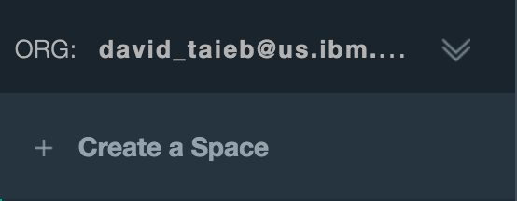
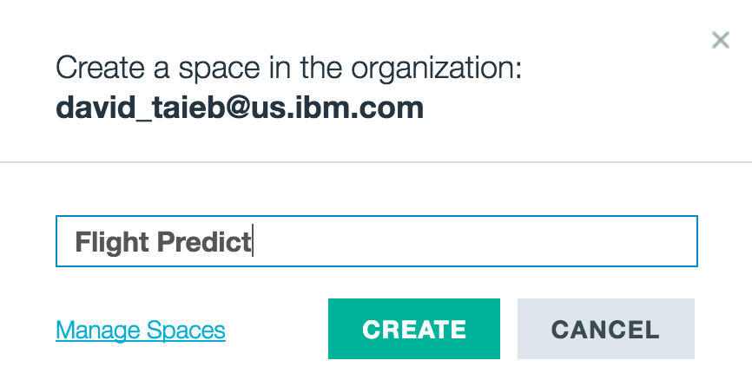
Create a new space on Bluemix
In preparation for running the project, we create a new space on Bluemix

Slide 5
STEP 2
Sign up for FlightStats

Slide 6

Sign up for a free trial at Flightstats.com
Sign up at https://developer.flightstats.com/signup
Fill out the form and monitor email for confirmation link (access to APIs may take up to 24 hours)
Once access is granted go to https://developer.flightstats.com/admin/applications to view appId and appKey (you will need them in the simple-data-pipe tool to create training sets.
Optional: get familiar with the various flightstats apis:
https://developer.flightstats.com/api-docs/scheduledFlights/v1
https://developer.flightstats.com/api-docs/airports/v1
Prepare your bluemix space

